Slide 1
TEAM 18 – PHASE 4
WNYLC
FAIR HEARING ONLINE RESOURCE CENTER
Monday, November 3, 2012
Adil Ansari
Ganesh Sayee Ramakrishnan
Robert Earl Scott Jr.
Madhura Suresh
Rajkumar TS

Slide 2
Problem Overview
The WNYLC is a group of lawyers that represent people who apply for Public Assistance in NY
The source for these hearings is the Office of Temporary Disability Assistance database
The online OTDA hearings older than 3 years will be removed
These hearings often contain a general discussion of the rules for obtaining benefits, and not useful to users and advocates

Slide 3
Project Objective
Devise techniques to identify useful hearings, and note them, and a way to search this large database
Allow advocates to comment on hearings that are particularly helpful
Define levels of access for different types of users
Introduce an email subscription process for users to receive updates

Slide 4
Our Proposal
Categorize the hearings into a broad group of topics, to make browsing easier
Advanced Search, with filters for more accurate information retrieval
Levels of Access for different types of users
Discussion Forum, where level 2,3,4 users can participate
Allow users to subscribe to a particular category of hearing decisions

Slide 5
Access Levels
Level 1: Regular Users
View access to everything
Cannot view or post comments
Level 2: Advocates
Granted via email request, with customized reply email
Can comment and has limited editing privileges
Level 3: Administrators
Give access to Level 2 users,
Can edit/remove comments posted by Level 2 users
Level 4: Super Administrators
Appoint, send correspondence to Level 3 Administrators
User access management; deletion and demoting users

Slide 6
Discussion Forum
Users at levels 2 and above can participate in discussions by posting their views for each hearing
Level 3 and 4 users are moderators; and Level 4 users have additional rights over Level 3 users

Slide 7
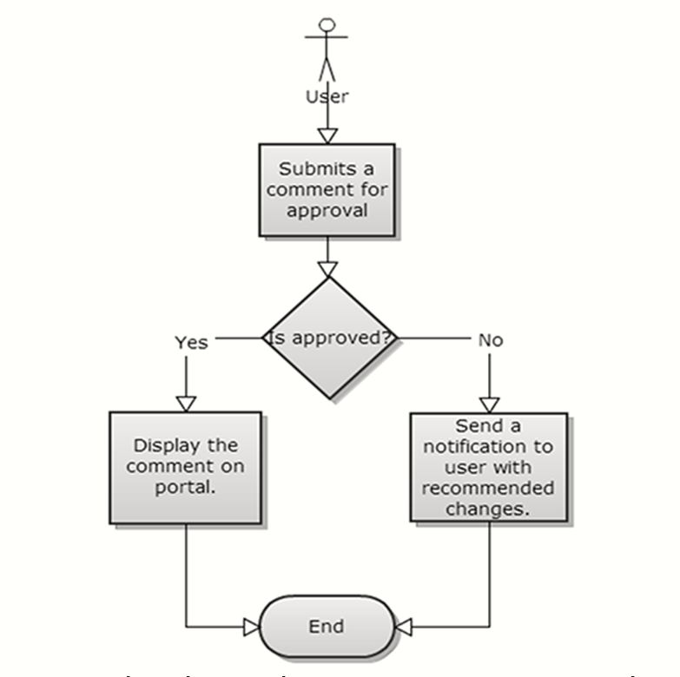
Illustrated: Discussion Forum

Slide 8
Advanced Search UI
The main search page is divided into 5 segments:
Monthly Archives
Recently Uploaded Cases
Category Listing
Filter cases by Results
Quick email subscription form

Slide 9
Illustrated: Advanced Search UI

Slide 10
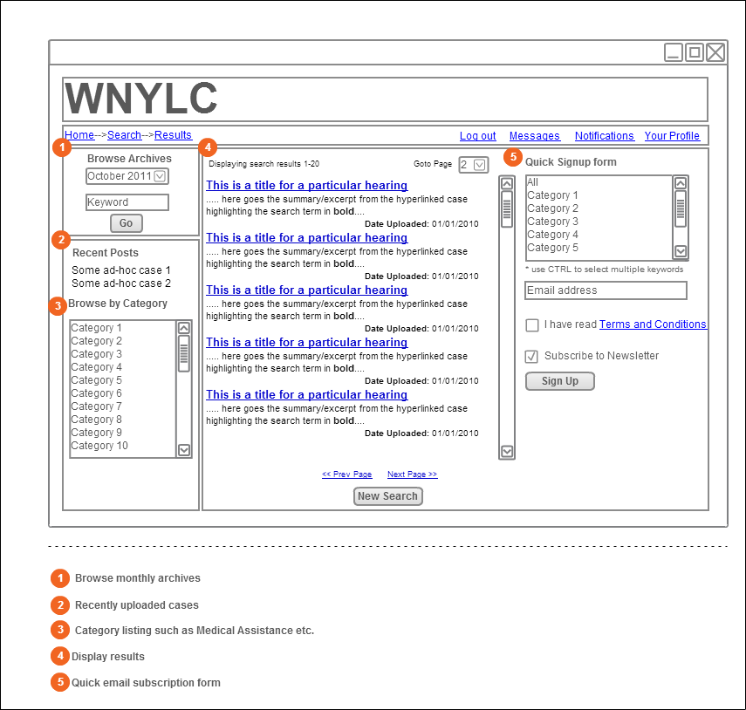

Slide 11
Future Expandability
Based on the user profile, applicant eligibility for a trial can be determined
Platform for a client to directly approach an advocate for a one-time consultation or a representation
Gargantuan task of storing data more than 12 years old
Adding restricted sections of the law

